Slide 1
Create a build and release pipeline for your open source project in Azure DevOps
Jeff Putz

Slide 2
About me
Working in software since 1999, from startups to gigantocorps like Microsoft.
Currently VP of Engineering at PowerDMS in Orlando.
Sixth year speaking at Orlando Code Camp.
Been nerding hard about roller coasters and theme parks with sites like CoasterBuzz.com for 20 years.
Maintainer of POP Forums for most of that time.
Doing stuff like this to maintain street cred.
Bits and decks: https://github.com/jeffputz
Blog: https://jeffputz.com/
The Twitter: @jeffputz

Slide 3
Prerequisites
A Microsoft account (formerly Live, formerly Windows Live, formerly Passport).
A public project on GitHub (formerly GitHub but not owned by Microsoft).
An organization and project on Azure DevOps (formerly Visual Studio Team Services, formerly Visual Studio Team System, formerly Visual Studio Online, formerly Team Foundation Server Online, formerly TFS running on an old comprooder under your desk).
An Azure subscription (mercifully only known previously as Windows Azure).

Slide 4
The Scenario
POP Forums is an open source project on GitHub.
CoasterBuzz uses POP Forums as the core of its membership system, and of course has a forum.
The latter is a means to put the former under load. Have to integrate quickly.
Need a CI site to validate build. https://popforumsdev.azurewebsites.net/
CI site is running on an Azure App Service with Azure Functions.

Slide 5
Code to software flow
GitHub Repository
Build Pipeline
Release Pipeline
Azure App Service
(and Azure Functions)

Slide 6
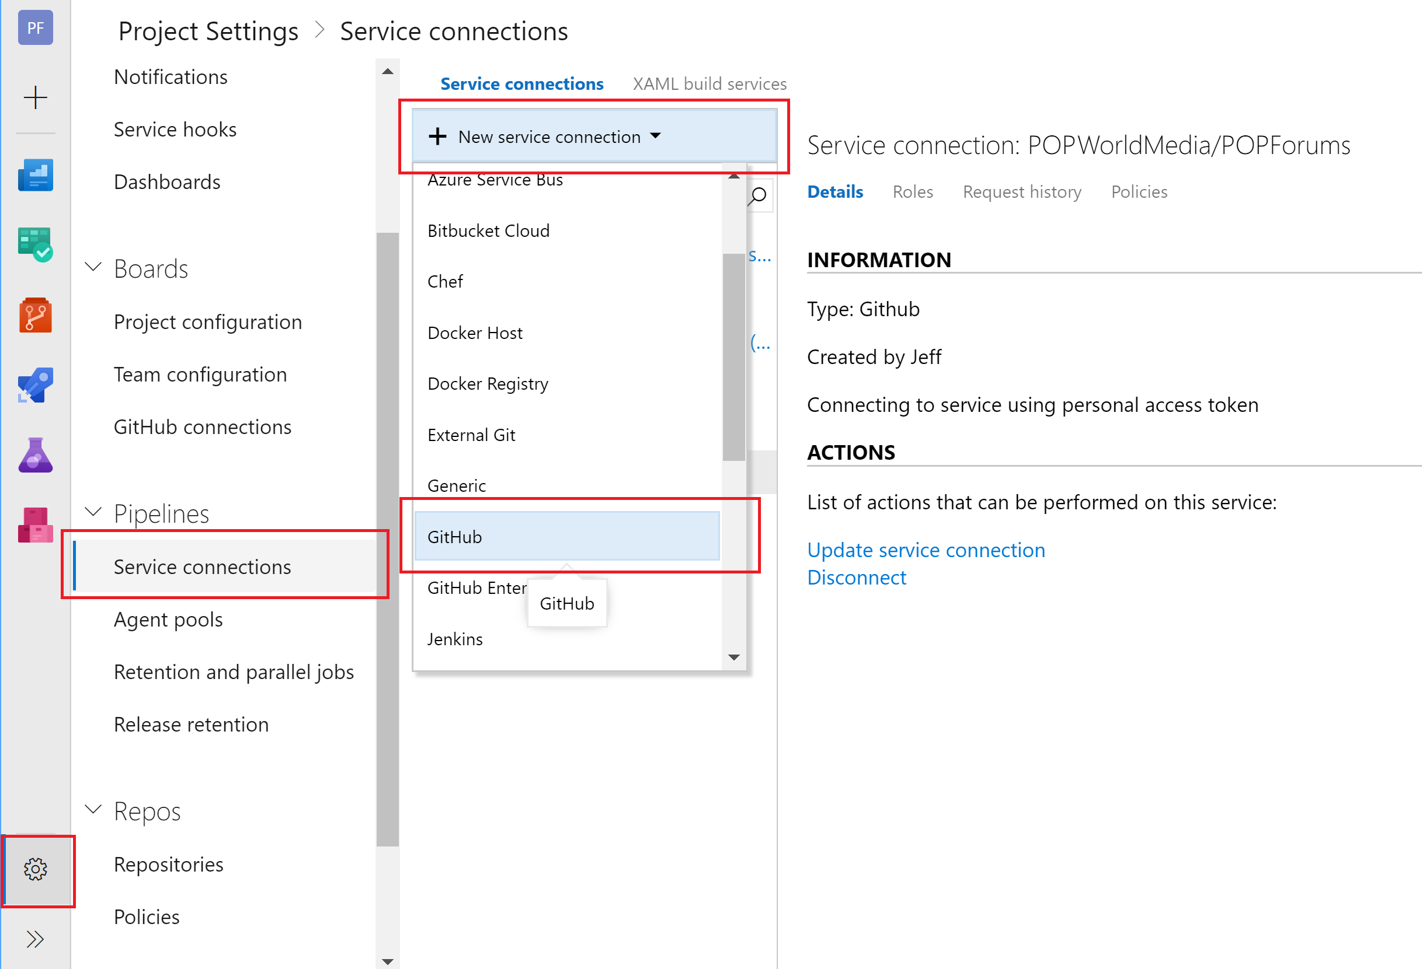
First step: Oauth to GitHub from Azure DevOps

Slide 7
Let’s talk about build/release agents in Azure DevOps
There are hosted (managed) agents, and there are self-hosted agents.
First hit is free. Multiple concurrent agents normally are not.
Public projects are entitled to 10 FREE hosted or self-hosted agents.
Hosted agents come in Windows, Linux and macOS flavors.
Hosted agents are basically ephemeral VM’s that will be thrown away. Like your Snapchats.
Self-hosted agents are faster because they can cache all of the stuff you otherwise have to install every time, like packages, SDK’s, npm, etc.
Your OSS project has a budget of $0 and those ungrateful consumers aren’t filling your tip jar, just asking you for help with basic software debugging.

Slide 8
Builds vs. deployments
They’re basically the same tools, differing only in triggers and gates.
The GUI components all map to stuff you can do from the command line… dotnet, npm, gulp, etc.
When in doubt, do it locally to figure out how to do something.
If you really want to live on the edge, do everything as a PowerShell script (may require your own build agent). If you’re really nutty, build a container image to build your app.

Slide 9
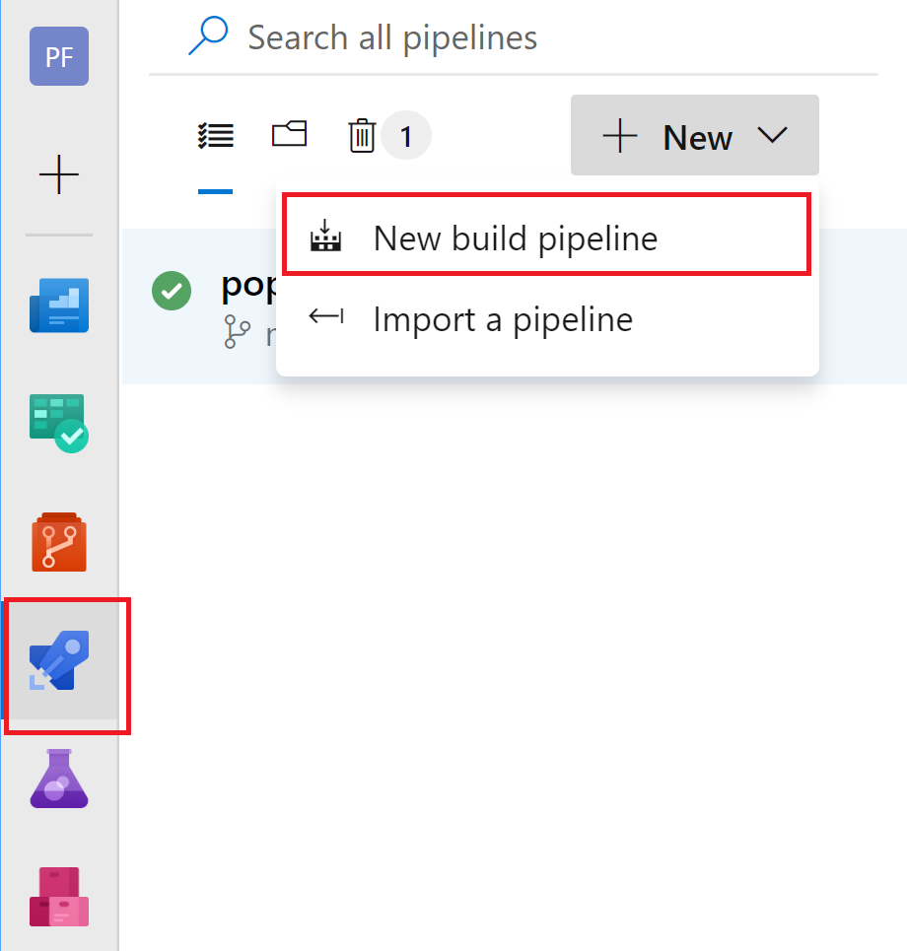
Create a new build pipeline

Slide 10
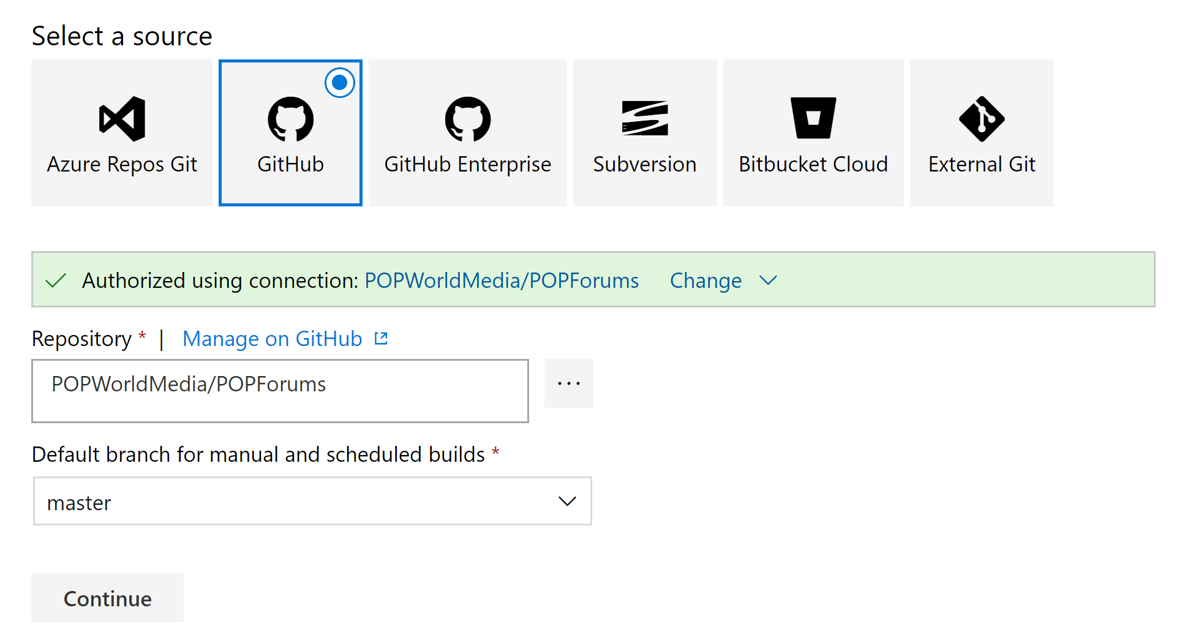
Choose your source repository

Slide 11
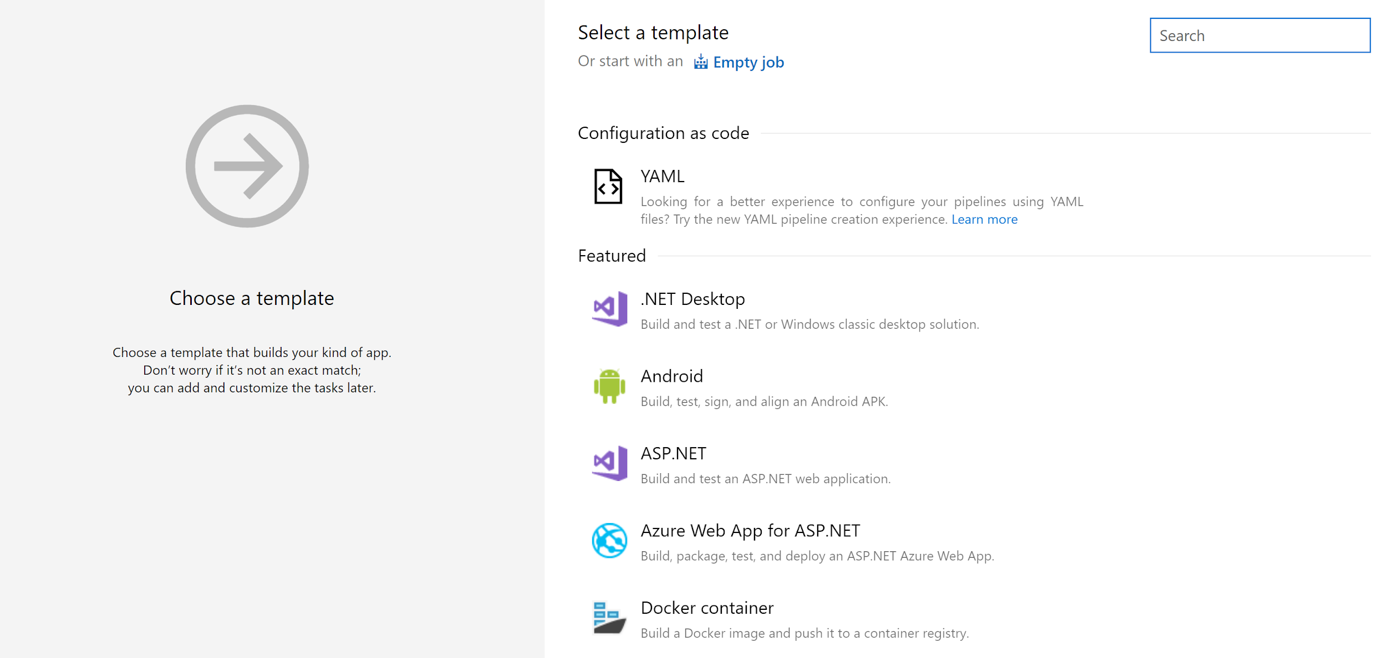
Select a build template

Slide 12
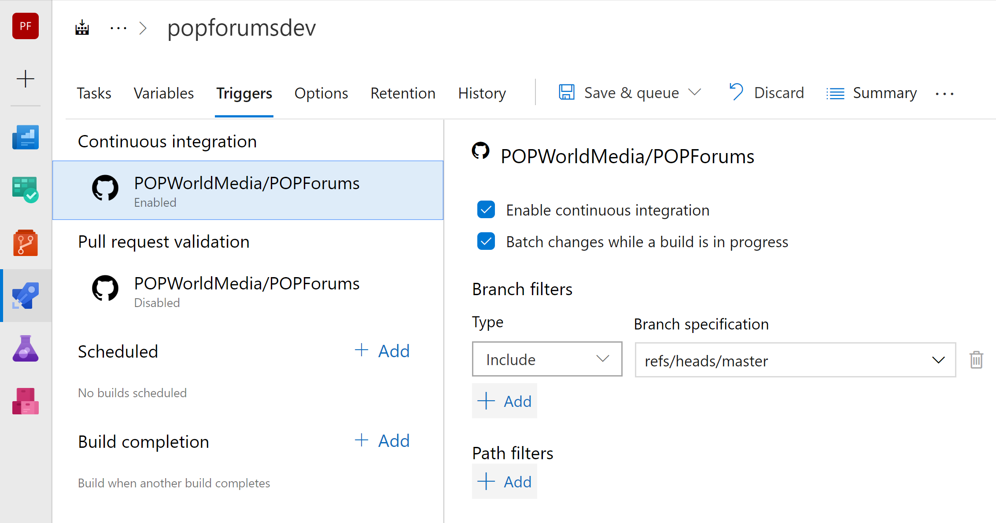
Triggering a build

Slide 13
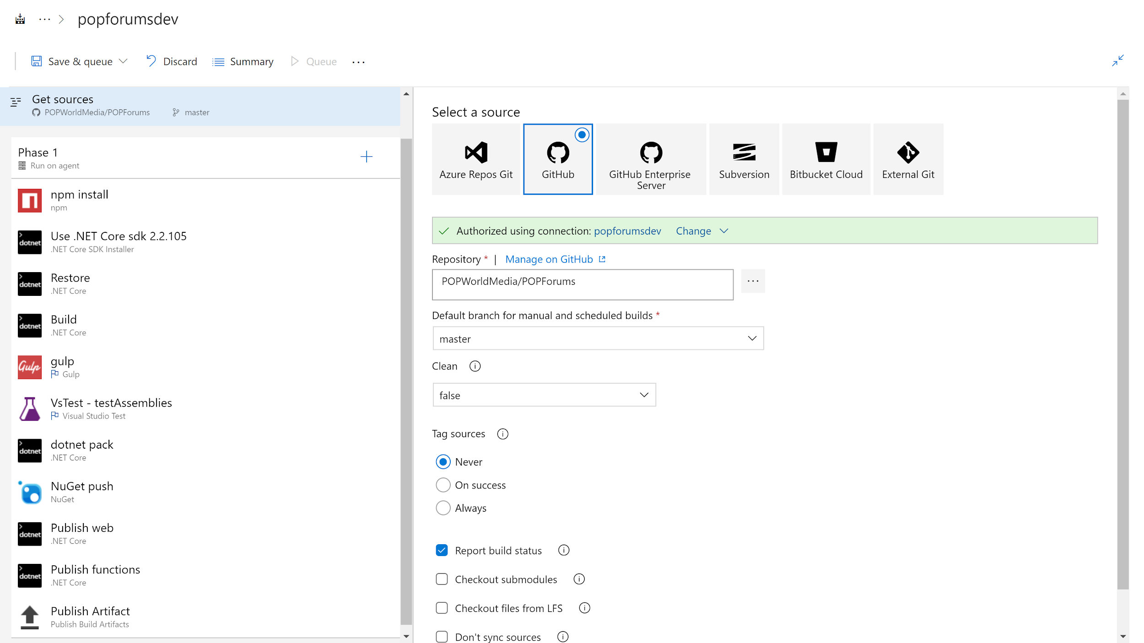
Build steps

Slide 14
LIVE BUILD!!!!!111! (and explanation of steps)

Slide 15
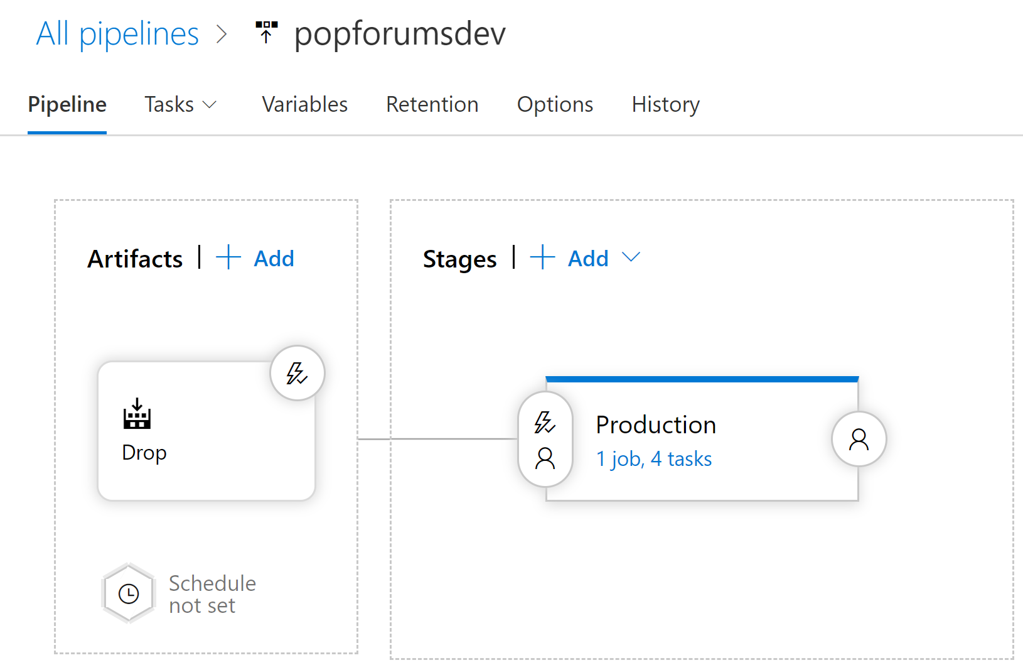
Release gates

Slide 16
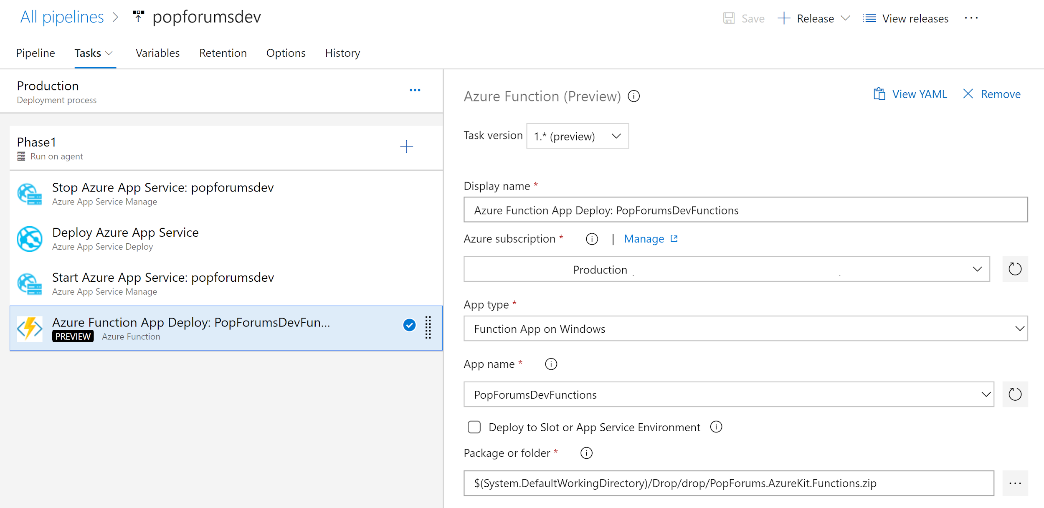
Release steps

Slide 17
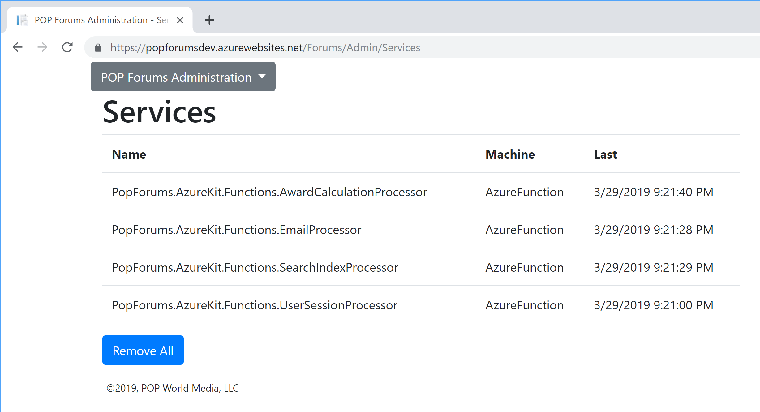
DEPLOYED!

Slide 18
Questions?

